Slide 1

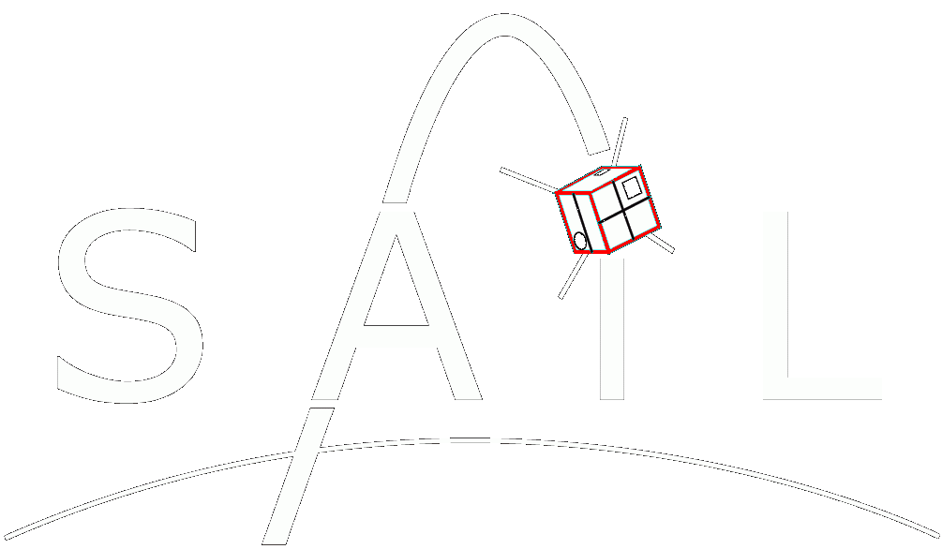
COMPASS
Computational Photometry Analyzer for Small Satellites

Slide 2
Overview
The Computational Photometry Analyzer for Small Satellites(COMPASS) is a desktop-based rendering engine written in C++ and OpenGL used to produce accurate graphical representations of RSOs (resident space objects) and their environments as observed by ground-based telescopes. These renderings are generated and processed within the program in order to infer additional information about the system including photometry data, RSO attitude, rotation frequency, etc. and provide a platform for testing image processing algorithms. An intuitive user interface is provided in order to visually correlate these renderings to the associated photometry data.

Slide 3
Why Should You (or anyone) Care?
Situational awareness in space.
Characterize space debris
Improve TLE with optical tracking
Better orbit decay models when the shape/size is known.
Spacecraft status analysis
Determine physical configuration of a satellite in LEO (e.g. make sure solar panels deployed)
Reconstruct attitude of the spacecraft. (e.g. determine how fast your spacecraft is spinning out of control ☺)
OSCOM Simulating
Image Processing Algorithms
CubeSat Design
Develop greater intuition for relating spacecraft orientation to photometry data
It’s Cool

Slide 4
V1.0.0 Requirements
COMPASS – V 1.0.0 Requirements Table
No. | Functional Requirement | Operational Requirements | Justification | Validation
1.0 | The program shall generate, record, and plot photometry data for the RSO during all simulations. | The sun shall be the only light source considered and it shall emit only white light. No ambient light shall be present. The surface albedo of the RSO shall be assumed to be exactly 1. The observing sensor shall collect 100% of the light reflected by the RSO that falls within its solid angle. | Generating accurate photometry data is a fundamental requirement of this program. The stated assumptions shall be maintained in order to ensure simplicity and ease of validation within the initial photometry model. | Compare to theoretical calculations made according to the same assumptions. Rendering simplified models in a fixed orientation at a fixed distance, calculate the brightness of the object and compare to simulation results. Repeat for several test cases.
1.1 | The sample rate for collecting photometry data shall be defined by the user. | The sample rate shall not be allowed to exceed the framerate of the application (60_{HZ}). | Sample rate should be definable according to the sensor being modelled. The sample rate is physically limited by the application framerate. Thus, it would be innacurate to assign higher sample rates. | N/A
2.0 | The program shall provide a manual mode in which the user may define the simulation parameters and observe their effects on photometry data. | The user shall define the direction of incoming light and the orientation of the RSO within three degrees of freedom. The angular velocity of the RSO may be defined within three degrees of freedom and up to any rate less than 30_{HZ}. The altitude of the RSO may be defined between 150km and 36,000km. | A manual mode provides the user with an intuitive means of correlating the specified parameters to photometry data. The target frame-rate of this application is 60 fps. Any angular velocity at or above 30_{HZ} would yield rendering errors due to aliasing. RSO’s at or below 150km will decay quickly. RSO’s at or above geosynchronous altitudes (~36,000km) are beyond the scope of this program. | N/A

Slide 5
2.1 | In manual mode, the user shall have the ability to rotate the camera to any desired orientation. | Camera orientation shall be defined within three degrees of freedom while always maintaining a focus on the RSO. | Allows user to inspect the entirety of the model under any given set of lighting and orientation conditions. | N/A
3.0 | The program shall implement a pass mode in which the RSO shall be rendered in orbit from the perspective of a ground-based observer and photometry data shall be generated and recorded. | The orbit of the RSO shall be modelled and propagated according to its TLE or a set of user-defined Keplerian elements. The time and duration of each pass shall be defined by the user. The Orientation and Angular velocity of the RSO shall be accurate according to its location in space relative to that of the observer, its orbital motion, and a set of user defined orientation and angular velocity parameters. The direction of incoming light shall be accurate according to the relative positions of the sun and the RSO at the time of observation. | The purpose of pass mode is to simulate the conditions under which actual observations occur. These simulations may be used to analyze the correlations between photometry data and the motion/orientation of an RSO. It may also be used to predict the photometry curve of an RSO in any particular orbit and any orientation. | Compare to actual photometry curves in which the orientation of the RSO is known. Check for similarities in the shape and magnitude of the curves (will not be exactly the same given the simplified photometry model). Compare to photometry curves generated according to alternate methods.
3.1 | The program shall notify the user when the RSO is not in direct sunlight at the time of observation. | This program will implement the algorithm created by last year’s senior design team. (REVISE THIS ONE) | Observing a satellite when it’s not illuminated is pointless. | Check according to different RSOs and the associated times in which they are illuminated.

Slide 6
How are we going to do it?
GitHub
Version Control
Team Software Development
C++
Speed and OpenGL compatibility.
OpenGL
Develop an accurate rendering model used to generate photometry data.
Use capabilities of graphics cards to render images and calculate brightness.
QT
Make things look nice.
CAD Software
Most likely Blender since it is a vertex-based modelling system.
SGP4
Orbit Propagation

Slide 7
Current State
Written in Java (because I used it for my CS225 project). Will start porting to C++ soon for added performance, using QT windowing/GUI system, OpenGL originally built for C++, and because there’s more support for OpenGL C++ than there is for Java.
Current Capabilities:
loads any STL, AMF, or OBJ model file.
User-set initial orientation/rotation of RSO, pass duration, and sample rate.
Renders RSO according to input parameters.
Measures brightness of RSO (based on pixel color values). Relative change in brightness is accurate, but these don’t correlate to actual units yet…
Displays live graph as RSO is rendered. Saves brightness data and allows it to be graphed again later within the program.
Camera orientation is fixed. In the future, this will be set according to the relative locations of the satellite and observer.
Orbital motion of satellite is not modelled yet. Buttons are there just for show at this point, but I was working implementing this towards the end of the previous semester.

Slide 8
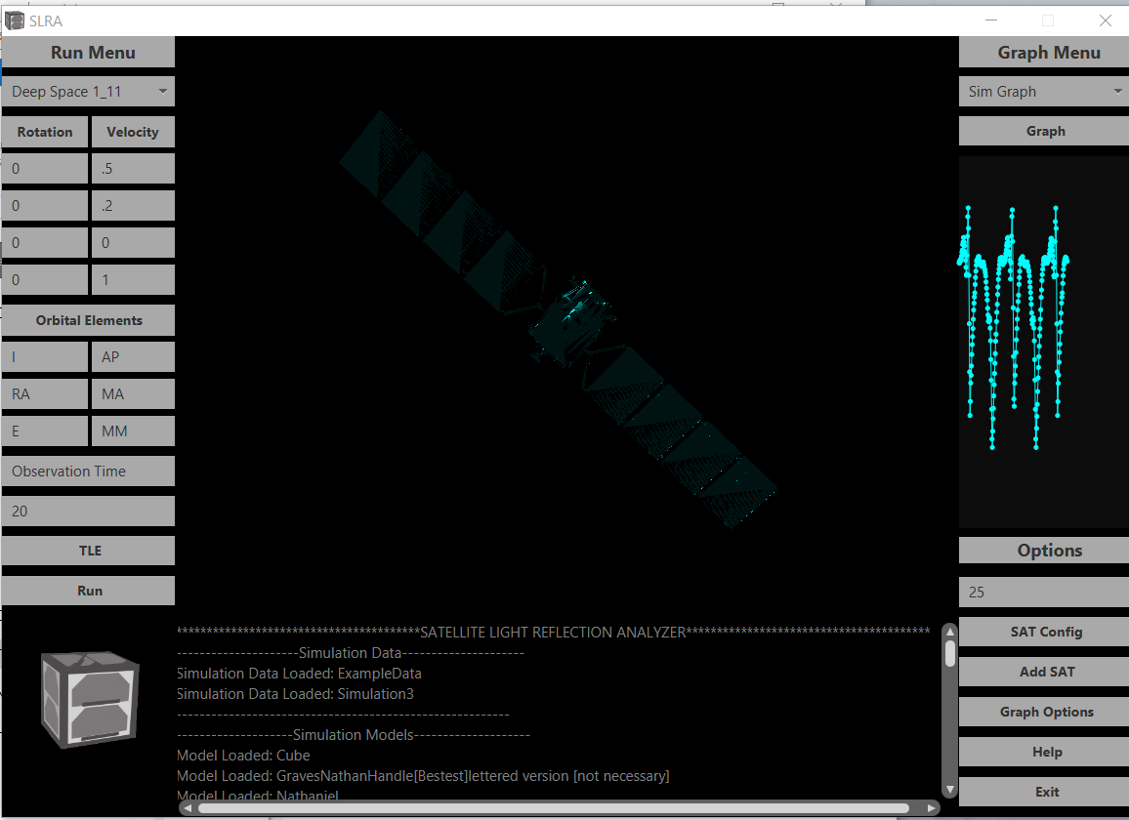
Select data to graph. (new data saved after every simulation)
Select RSO Model
Graph selected simulation in a separate window.
Set Rotation axes for initial orientation and angular velocity
Live graph of RSO brightness. (No units, just shows relative change in brightness for now).
Set initial rotation amount (degrees) or angular velocity (hertz)
Random satellite model from NASA’s website. Default texture is Cyan colored (No particular reason).
Manual orbital elements input… Probably wont use this in the future. Just use TLE
J2000 time of observation. Not implemented yet
Duration of pass. (How long the RSO is rendered)
Does absolutely nothing. Future: set RSO TLE
Sample rate for brightness data. (Hertz)
Run a simulation based on the current parameters
Open a file browser to add a new satellite model.
Output console. Helps with debugging n’ such
Super cool satellite logo that may-or-may-not have been stolen from Spacecraft Development Club…

Slide 10
